Slide 1
Toxic comment
Sandro Erba – 856327
Alice Hoa Galli – 856648
Elia Gaviraghi - 869493

Slide 2
Introduzione
Necessità
Bisogno di limitare commenti offensivi
Contesto
Obiettivo
L’uso dei social può sfociare in discussioni con un linguaggio offensivo
Sviluppare un modello in grado di individuarli

Slide 3
Descrizione dataset
Commento dal contenuto tossico
Commento contenente una minaccia
Toxic
Threat
Commento dal contenuto particolarmente tossico
Commento contenente un insulto
Severe toxic
Insult
Commento dal contenuto osceno
Commento razzista
Obsene
Identity hate

Slide 4
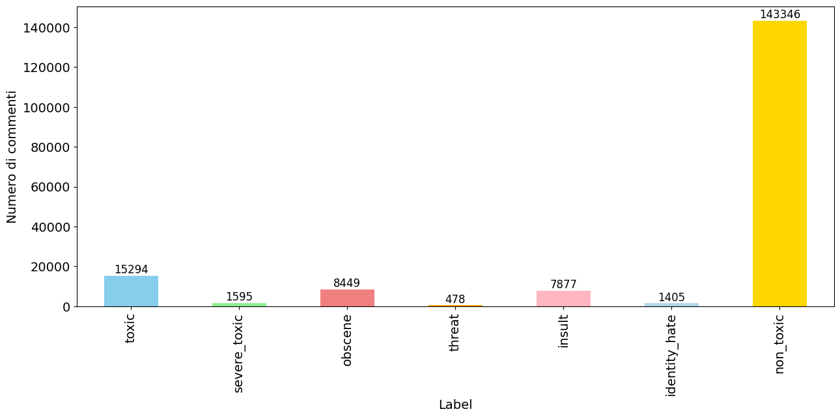
Ispezione dataset – distribuzione label (1/2)

Slide 5
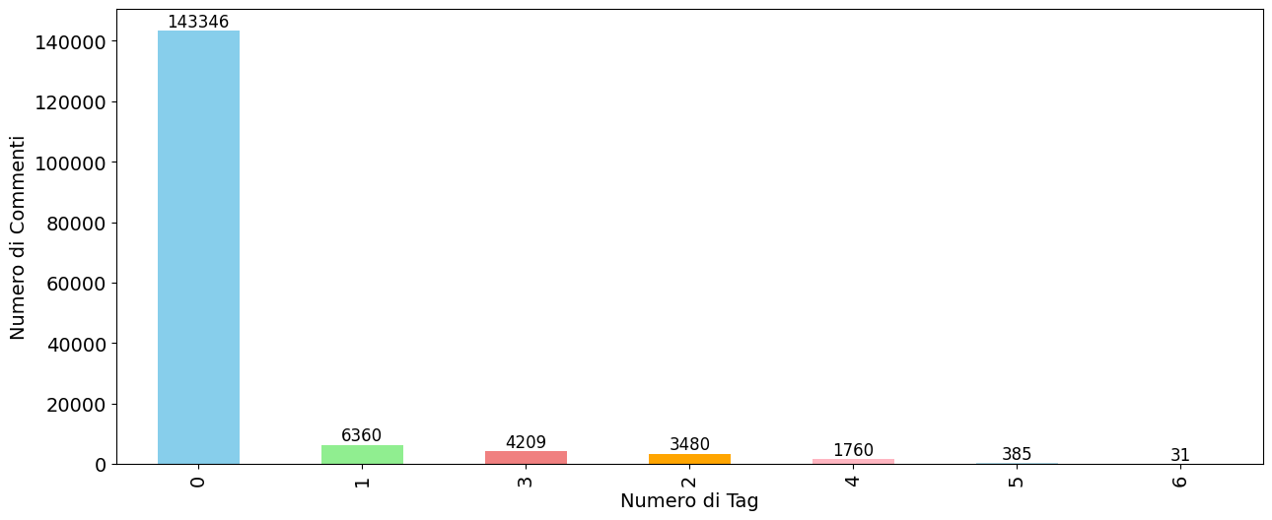
Ispezione dataset – distribuzione label (2/2)

Slide 6
Approcci agli sbilanciamenti
Random undersampling
Data augmentation
Calcolo pesi
Diminuzione randomica dei non-toxic comment
Tentativo di bilanciare il numero di commenti etichettati come threat, identity hate e severe toxic
Durante il train di addestramento i pesi vengono passati come parametro

Slide 7
Data cleaning
Pulizia tramite pattern
Eliminazione punteggiatura
Uso di espressioni regolari per rimuovere termini con diversa sintassi ma identica semantica
Rimozione segni punteggiatura
Lemmatization
Stop-word removal
Sostituzione di tutte le parole con il corrispondente lemma
Rimozione delle stop-word

Slide 8
Data pre-processing
Tokenization
Padding
Suddivisione dei commenti in token
Aggiunta di padding per uniformare la lunghezza delle sequenze
Text encoding
Conversione dei token in sequenze numeriche

Slide 9
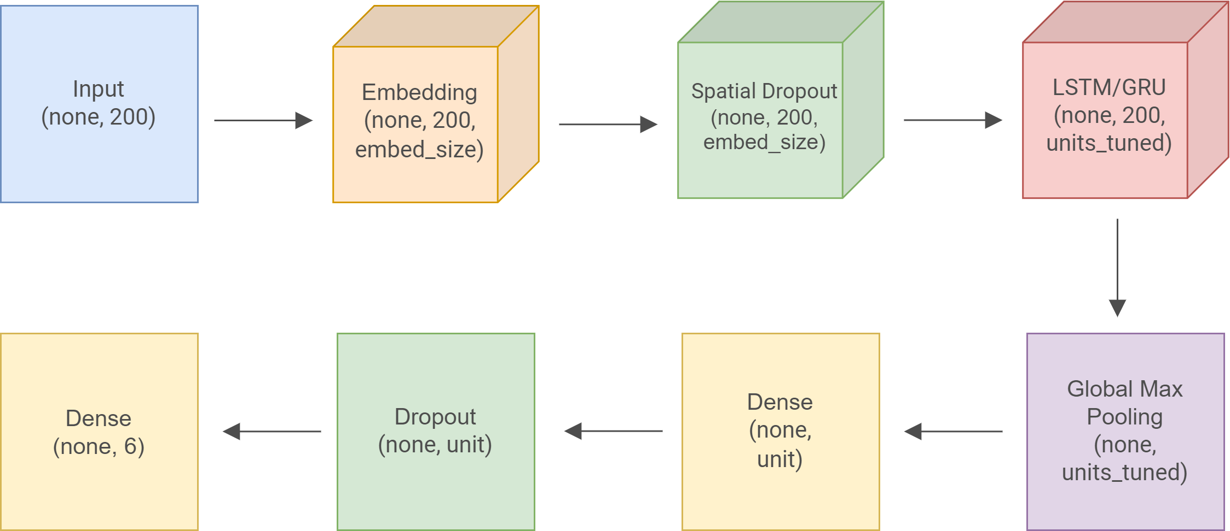
RNN

Slide 10
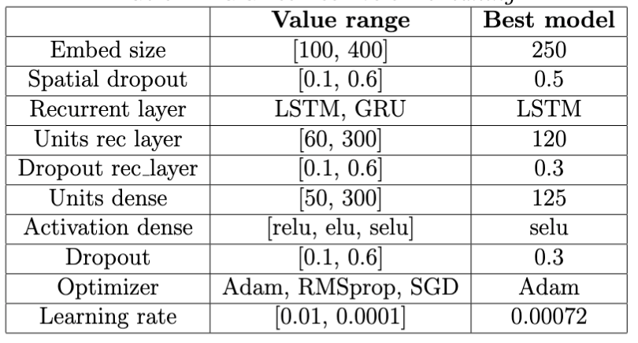
Tuning parametri

Slide 11
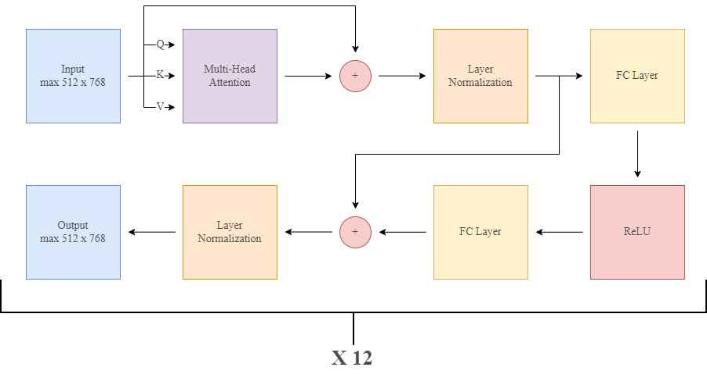
Transformer

Slide 12
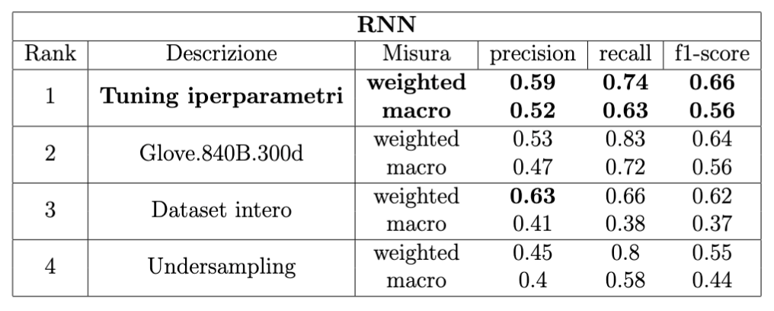
Risultati – RNN

Slide 13
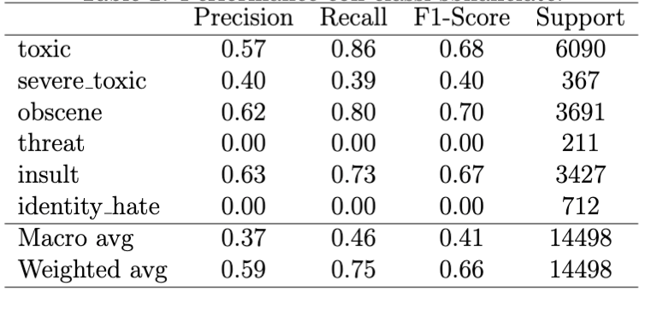
Risultati – Transformer (1/3)

Slide 14
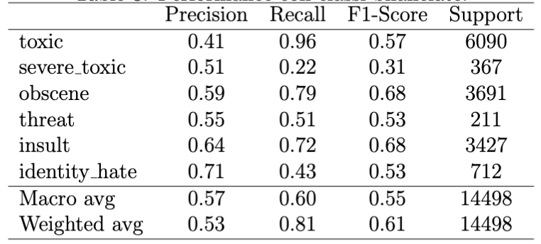
Risultati – Transformer (2/3)

Slide 15
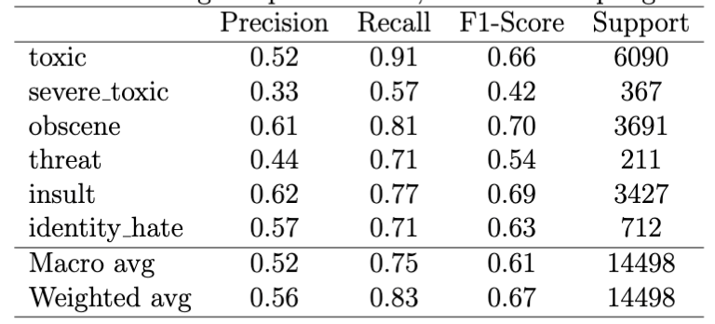
Risultati – Transformer (3/3)

Slide 16
Discussione

Slide 17
Conclusione

Slide 18
Bullying Infographics
Mars is actually a very cold place
Jupiter is the biggest planet of them all
Mercury is the closest planet to the Sun
Earth is the planet where we all live on
Pluto is considered a dwarf planet
Ceres is in the main asteroid belt

Slide 19
Bullying Infographics
Mars
Neptune
Despite being red, Mars is a cold place
It’s the farthest planet from the Sun
Venus
Jupiter
Venus is the second planet from the Sun
It’s a gas giant and the biggest planet

Slide 20
Bullying Infographics
75%
65%
Venus
Jupiter
Venus is the second planet from the Sun
It’s a gas giant and the biggest planet
45%
35%
Mars
Neptune
Despite being red, Mars is a cold place
It’s the farthest planet from the Sun

Slide 21
Bullying Infographics
Venus
Jupiter
Venus is the second planet from the Sun
It’s a gas giant and the biggest planet
Mars
Neptune
Despite being red, Mars is a cold place
It’s the farthest planet from the Sun

Slide 22
Bullying Infographics
Venus is the second planet from the Sun
Despite being red, Mars is a cold place
Venus
Mars
Mercury is the closest planet to the Sun
Jupiter is the biggest planet of them all
Mercury
Jupiter
Neptune is the farthest planet from the Sun
Saturn is a gas giant and has several rings
Neptune
Saturn

Slide 23
Bullying Infographics
Venus
Mars
Jupiter
Neptune
It’s terribly hot, and its atmosphere is extremely poisonous
It's full of iron oxide dust, which gives the planet its reddish cast
Jupiter is a gas giant and the biggest planet in the Solar System
It was named after the Roman god of wealth and agriculture

Slide 24
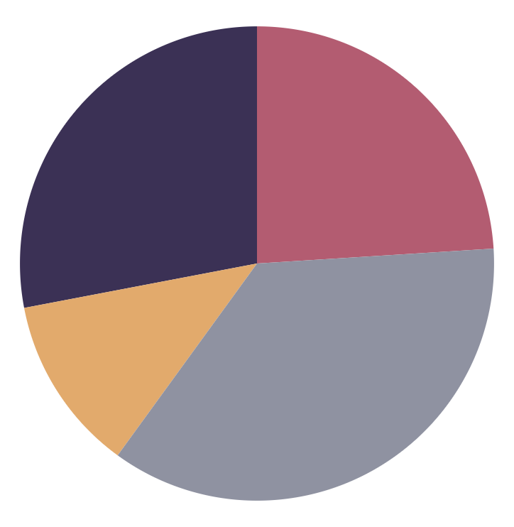
Bullying Infographics
28%
24%
Venus
Jupiter
Venus is the second planet from the Sun
It’s a gas giant and the biggest planet
12%
36%
Mars
Neptune
Despite being red, Mars is a cold place
It’s the farthest planet from the Sun
Follow the link in the graph to modify its data and then paste the new one here. For more info, click here

Slide 25
Bullying Infographics
Venus
Mars
Venus is the second planet from the Sun
Despite being red, Mars is a cold place
Mercury
Jupiter
Mercury is the closest planet to the Sun
Jupiter is the biggest planet of them all
Neptune
Saturn
Neptune is the farthest planet from the Sun
Saturn is a gas giant and has several rings

Slide 26
Bullying Infographics
Mars
Despite being red, Mars is a cold place
Mercury
Mercury is the closest planet to the Sun
Jupiter
Jupiter is the biggest planet of them all
Neptune
Neptune is the farthest planet from the Sun
Saturn
Saturn is a gas giant and has several rings

Slide 27
Bullying Infographics
Venus
Mars
Venus is the second planet from the Sun
Despite being red, Mars is a cold place
Characteristics
Characteristics
Characteristic 1
Characteristic 2
Characteristic 1
Characteristic 2
Mercury
Jupiter
Mercury is the closest planet to the Sun
Jupiter is the biggest planet of them all
Characteristics
Characteristics
Characteristic 1
Characteristic 2
Characteristic 1
Characteristic 2

Slide 28
Bullying Infographics
Venus
Mars
Jupiter
Despite being red, Mars is actually a cold place and it’s full of iron oxide dust
Venus is the second planet from the Sun
Saturn is the ringed planet and a gas giant
Neptune is the farthest planet from the Sun
Ceres is located in the main asteroid belt
Mercury is the smallest planet in the Solar System
Jupiter is a gas giant and the biggest planet in the Solar System

Slide 29
Bullying Infographics
Venus
Mars
Jupiter
Venus is the second planet from the Sun
Despite being red, Mars is a cold place
Jupiter is the biggest planet of them all
Mercury
Saturn
Neptune
Mercury is the closest planet to the Sun
Saturn is a gas giant and has several rings
Neptune is the farthest planet from the Sun

Slide 30
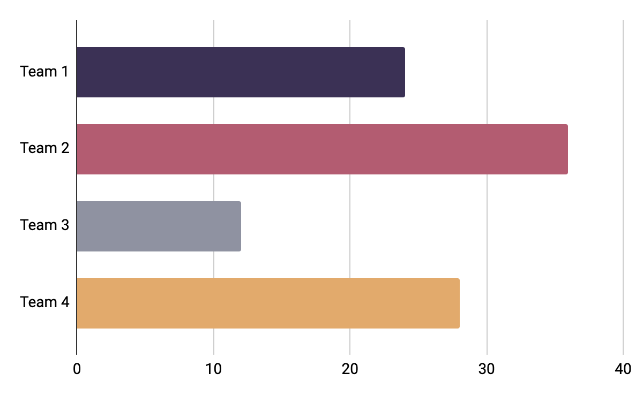
Bullying Infographics
Venus
Jupiter
Venus is the second planet from the Sun
It’s a gas giant and the biggest planet
Mars
Neptune
Despite being red, Mars is a cold place
It’s the farthest planet from the Sun
Follow the link in the graph to modify its data and then paste the new one here. For more info, click here

Slide 31
Bullying Infographics
25%
75%
Venus
Neptune
Venus has a beautiful name, but also very high temperatures
Mercury is the closest planet to the Sun and the smallest of them all

Slide 32
Bullying Infographics
Harassment | Describe the case here
Flaming | Describe the case here
Exclusion | Describe the case here
Outing | Describe the case here
Masquerading | Describe the case here

Slide 33
Bullying Infographics
Venus
01
Venus is the second planet from the Sun
Mars
02
Despite being red, Mars is a cold place
Jupiter
03
It’s a gas giant and the biggest planet

Slide 34
Bullying Infographics
Venus
Mars
Venus is the second planet from the Sun
Despite being red, Mars is a cold place
30%
40%
Mercury
Jupiter
Mercury is the closest planet to the Sun
Jupiter is the biggest planet of them all
70%
50%

Slide 35
Bullying Infographics
100%
50%
75%
Venus
Mars
Jupiter
Venus is the second planet from the Sun
Despite being red, Mars is a cold place
Jupiter is the biggest planet of them all

Slide 36
Bullying Infographics
Bullying
Venus
Mars
Venus is the second planet from the Sun
Despite being red, Mars is a cold place
Neptune
Jupiter
Saturn
Neptune is the farthest planet from the Sun
Jupiter is the biggest planet of them all
Saturn is a gas giant and has several rings

Slide 37
Bullying Infographics
Venus
01
Venus is the second planet from the Sun
Mars
02
Despite being red, Mars is a cold place
Mercury
03
Mercury is the closest planet to the Sun
Neptune
04
Neptune is the farthest planet from the Sun

Slide 38
Bullying Infographics
30%
20%
Venus
Mars
Venus is the second planet from the Sun
Despite being red, Mars is a cold place
60%
40%
Mercury
Neptune
Mercury is the closest planet to the Sun
Neptune is the farthest planet from the Sun

Slide 39
Bullying Infographics
Saturn
Mars
Saturn is a gas giant and has several rings
Mercury
Despite being red, Mars is a cold place
Venus
Mercury is the closest planet to the Sun
Venus is the second planet from the Sun

Slide 40
Bullying Infographics
01
03
Venus
Jupiter
Venus is the second planet from the Sun
It’s a gas giant and the biggest planet
02
04
Mars
Neptune
Despite being red, Mars is a cold place
It’s the farthest planet from the Sun

Slide 41
Bullying Infographics
25%
75%
Boys
Girls
Despite being red, Mars is actually cold
Venus is the second planet from the Sun
Neptune is the farthest planet from the Sun
Ceres is located in the main asteroid belt
Mercury is the smallest planet of them all
Jupiter is a gas giant and the biggest planet
Saturn is the ringed planet and a gas giant
Despite being red, Mars is a cold place
Suffered bullying
Did not suffer bullying

Slide 42
Bullying Infographics
Mars is actually a very cold place
Jupiter is the biggest planet
The Moon is our natural satellite
Mercury is the smallest planet
Earth is the planet where we all live on
It’s the smallest one in the Solar System
Pluto is considered a dwarf planet
Ceres is in the main asteroid belt
Earth is the only one that harbors life
Venus is even hotter than Mercury
Saturn is a gas giant and has rings
It was named after a Roman god

Slide 43
Bullying Infographics
Types of bullying
Venus
Jupiter
Venus has a beautiful name, but also very high temperatures
Jupiter is a gas giant and the biggest planet in the Solar System
Neptune
Mercury is the closest planet to the Sun and the smallest

Slide 44
Bullying Infographics
Mars | Despite being red, Mars is a cold place | It’s the biggest planet in the solar system | Pluto is considered a dwarf planet
Venus | Venus is the second planet from the Sun | Earth is the planet where we live on | It’s the farthest planet from the Sun
Percentage | 15% | 75% | 50%
Numbers | 1.548,25 | 5.879,15 | 66.357

Slide 45
Bullying Infographics
Venus
Mars
Jupiter
Venus is the second planet from the Sun
Despite being red, Mars is a cold place
Jupiter is the biggest planet of them all
Mercury
Saturn
Neptune
Mercury is the closest planet to the Sun
Saturn is a gas giant and has several rings
Neptune is the farthest planet from the Sun

Slide 46
Bullying Infographics
65%
Venus
25%
Jupiter
Venus is the second planet from the Sun
It’s a gas giant and the biggest planet
45%
Mars
35%
Neptune
Despite being red, Mars is a cold place
It’s the farthest planet from the Sun

Slide 47
Bullying Infographics
How to distinguish bullying?
Mercury
01
It’s the closest planet to the Sun and the smallest in the Solar System
Venus
02
Venus has a beautiful name and is the second planet from the Sun
Mars
03
Despite being red, Mars is actually a cold place. It’s full of iron oxide dust

Slide 48
Instructions for use (premium users)
As a Premium user, you can use this template without attributing Slidesgo or keeping the "Thanks" slide.
You are allowed to:
Modify this template.
Use it for both personal and commercial purposes.
Hide or delete the “Thanks” slide and the mention to Slidesgo in the credits.
Share this template in an editable format with people who are not part of your team.
You are not allowed to:
Sublicense, sell or rent this Slidesgo Template (or a modified version of this Slidesgo Template).
Distribute this Slidesgo Template (or a modified version of this Slidesgo Template) or include it in a database or in any other product or service that offers downloadable images, icons or presentations that may be subject to distribution or resale.
Use any of the elements that are part of this Slidesgo Template in an isolated and separated way from this Template.
Register any of the elements that are part of this template as a trademark or logo, or register it as a work in an intellectual property registry or similar.
For more information about editing slides, please read our FAQs or visit Slidesgo School:
https://slidesgo.com/faqs and https://slidesgo.com/slidesgo-school

Slide 49
Infographics
You can add and edit some infographics to your presentation to present your data in a visual way.
Choose your favourite infographic and insert it in your presentation using Ctrl C + Ctrl V or Cmd C + Cmd V in Mac.
Select one of the parts and ungroup it by right-clicking and choosing “Ungroup”.
Change the color by clicking on the paint bucket.
Then resize the element by clicking and dragging one of the square-shaped points of its bounding box (the cursor should look like a double-headed arrow). Remember to hold Shift while dragging to keep the proportions.
Group the elements again by selecting them, right-clicking and choosing “Group”.
Repeat the steps above with the other parts and when you’re done editing, copy the end result and paste it into your presentation.
Remember to choose the “Keep source formatting” option so that it keeps the design. For more info, please visit Slidesgo School.

